Slide 1



Time Series

Slide 2

DEFINITIONS
A time series is a sequence of values taken at regular time intervals: y = y(t).
Granularity or time lag: frequency in which the values are recorded. (seconds, hours, days, months, years,...)
We can decrease the granularity by doing aggregations (sums, averages,...etc).
We can’t increase the granularity.

Slide 3
MISSING VALUES IN TIME SERIES
In a TS, the strategies to fill missing values depends on the number of consecutive missing values. There are several possibilities:
Single one:
mean(y(t-1), y(t+1))
Feedforward: (use the previous value)
Several ones:
Reproduce the TS over the previous period
Interpolation
Random value following the same distribution during the period.

Slide 4

ASSUMPTIONS OF TIME SERIES
Any other external factor involved in the evolution of “y” is ignored.
It’s assumed that the next value of “y” can be predicted based only on the previous values of “y”

Slide 5
STATIONARITY
A “rolling window” is a subset of all the values which is displacing over the whole set.
A time series is said to be stationary if it has three properties:
Constant mean over a rolling window: (doesn’t show a trend)
Constant variance over a rolling window: ( doesn’t show changing fluctuations)
Covariance only depends on the time lag

Slide 6
HOW TO CHECK FOR STATIONARITY
Qualitatively: visually after plotting your time series!
Quantitatively: statistical test:
Augmented Dicker-Fuller test.
H0: The series is NOT stationary.
H1: The series IS stationary..
KPSS test:
H0: The series IS stationary
H1: The series is NOT stationary
(yes! Both tests have opposite null hypotheses)

Slide 7
TO BE, OR NOT TO BE….
ADF\KPSS | Stationary | No stationary
Stationary | Stationary | TS needs differencing
No stationary | TS needs differencing | No stationary

Slide 8
MAKING A TIME SERIES STATIONARY
Non-constant mean:
Create a new time series by taking differences of consecutive values:
z1(t) =y(t)-y(t-1)
z2(t) = z1(t) - z1(t-1) = y(t) - y(t-1) - ( y(t-1) - y(t-2) ) = y(t) -2y(t-1) + y(t-2)
….
Plot the the differenced series. The optimal value d is the lowest which makes the time series stationary
Non-constant variance:
Take the log(y(t))

Slide 9
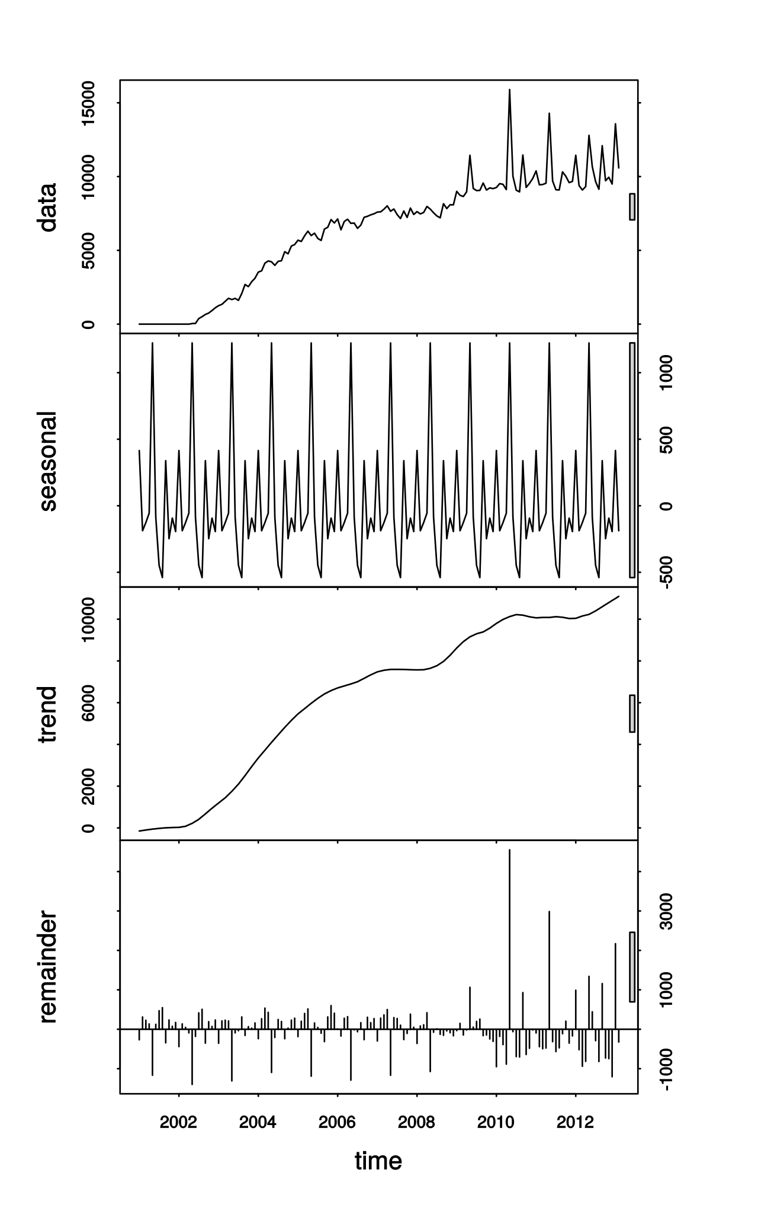
DECOMPOSING A TIME SERIES:
A Time Series can be expressed as a additive contributions or multiplicative contributions:
Additive: y(t) = T(t) + S(t) + R(t) + C(t)
Multiplicative: y(t) = T(t) * S(t) * R(t) * C(t)
Where:
T = trend
S = seasonality (repetitive patterns with constant frequency)
R = random (everything else)
C = Cyclic: (repetitive pattern with no constant frequency)

Slide 10
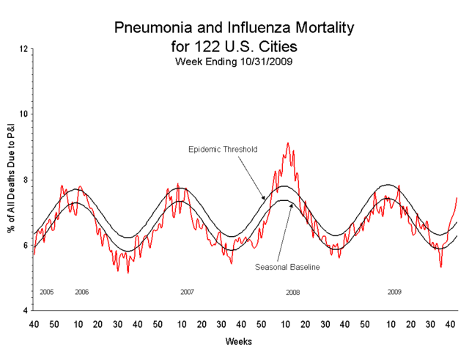
SEASONALITY OF A TIME SERIES:
The seasonality of a time series is a repetitive pattern within a year: the series repeats itself after several lags.
It can be removed subtracting values at the same frequency/lag of the seasonality.

Slide 11
ACF OF A TIME SERIES:
ACF: Auto-correlation function: measures how each value y(t) is correlated with another previous value y(t-lag*dt).
There are two ways in which one value can depend on previous values.
Directly
Indirectly
y_t-2
y_t-1
y_t
y_t-2
y_t-1
y_t

Slide 12
ACF OF A TIME SERIES:
ACF: Auto-correlation function: measures how each value y(t) is correlated with another previous value y(t-lag*dt)
If the time series has a trend, the ACF will decay slowly because every value will be highly correlated to the previous ones.
When the time series has seasonality, the ACF will show bigger peaks for the seasonal lags (at multiples of the seasonal frequency) than for other lags.
When the time series has trend and seasonality the ACF will show both patterns.

Slide 13
PACF OF A TIME SERIES:
PACF: Partial auto-correlation function: measures how each value y(t) is correlated with another previous value y(t-lag) after removing indirect dependencies
It only takes into account direct effects

Slide 14
TRAIN TEST SPLIT:
When training any model of a TS, we can’t use the usual train test split because we can break our TS signal.
The train-test split must be done based on time:
Train = y(t) for t < threshold ~(80%)
Test = y(t) for t > threshold ~(20%)
However:
A model that reproduces the test set, will not necessarily forecast well!
A perfect fit, can be achieved with a model with enough parameters

Slide 15

BASIC TIME SERIES MODELS: AR(p)
The most basic model is an Auto-Regresive model.
It uses the previous values to predict the next value using a linear model:
How many values in the past we need to consider in our model?
Temptative values for “p” can be found by looking the highest significant peaks above the “confidence bands” in the PACF.

Slide 16
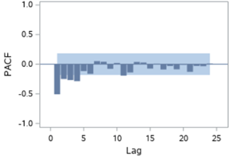
BASIC TIME SERIES MODELS: AR(p)
Example:
Potential values for p are: 1,2,3,4.
Then we can try the following models:
AR(1), AR(2), AR(3), AR(4)

Slide 17

BASIC TIME SERIES MODELS: MA(q)
The most basic model is an Moving Average model.
It uses the previous errors (of a mean model) to predict the next value using a linear model:
How many errors terms we need to consider in our mode?
“q” can be found by looking the highest significant peaks above the “confidence bands” in the ACF.
Epsilon is based on the error made using a model which predicts the mean value of “y”
MA models can only predict up to “q” values in the future! Beyond that they will predict the constant term.

Slide 18
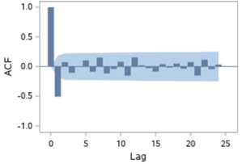
BASIC TIME SERIES MODELS: MA(q)
Example:
Potential values for q are 1 and 2:
The we can try the following models:
MA(1), MA(2)

Slide 19
BASIC TIME SERIES MODELS: ARMA(p,q)
An ARMA model is a model which combines an AR(p) model with and MA(q) model:
ARMA(p,q) = AR(p) + MA(q)
The temptative values of p and q are determined in the same way as the individual models. Looking at the ACF and PACF.

Slide 20
BASIC TIME SERIES MODELS: ARIMA(p,d,q)
The ARIMA(p,d,q) = AR(p) + D(d)+ MA(q) is a ARMA model which uses the original TS with “d” differences.
Instead of modelling the original TS, it models a new one in which every value has been subtracted the previous value.
W(t) = y(t) - y(t-1) if (d = 1)
Z(t) = W(t) - W(t-1) = (y(t) - y(t-1)) - (y(t-1) - y(t-2)) = y(t) - 2y(t-1) + y(t-2) if (d= 2)
…
Then the model predicts W(t) or Z(t) instead of the original y(t) and then undo the differences.

Slide 21
BASIC TIME SERIES MODELS: ARIMA(p,d,q)
ARIMA models are typically used when the TS has a clear upwards or downwards trend.

Slide 22
BASIC TIME SERIES MODELS: SARIMA(p,d,q,P,D,Q,m)
The SARIMA(p,d,q)(P,D,Q,m) model is a model that:
uses one ARIMA(p,d,q) model for the non-seasonal part of the TS
uses one ARIMA(P,D,Q,m) for the seasonal part of the TS
m is the number of “records” in a year

Slide 23
Holt-Winters
The basic idea of the Holt-Winters method is to use the the past values of the TS to make the prediction based on the most recent values (introducing some weights for every past value).

Slide 24

FACEBOOK’S PROPHET (I)
Facebook (yes, back then was still Facebook) created a very good TS model which decomposed the time series into:
The first term is called “growth”, the second term “seasonality” and the last term “holidays” (to take into account “calendar effects”).

Slide 25
FACEBOOK’S PROPHET (II)
Changepoints:
Are points in the data where the trend changes (after a peak)
The model is different in each pair of consecutive changepoints
The growth term can be modelled in three ways:
Linear: g(t)= b + mt
Logistic: g(t)=C(t)/(1+x^(-k(t-m)
Flat: g(t)=C

Slide 26
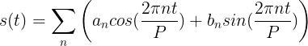
FACEBOOK’S PROPHET (III)
The seasonality term is modeled by finite sum of periodic functions:
The holiday term only takes into account is one day is holiday or not to be ready for unexpected peaks.
We can install prophet using:
pip install pystan
pip install fbprophet

Slide 27
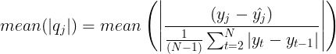
EVALUATING MODELS:
In TS the way to evaluate model is by looking at several things:
Residuals: mean(y - y_pred) ~ 0
Correlations: mean( corr(y,(y - y_pred) ) ~ 0
Plot
Residuals: (y - y_pred)
ACF of the residuals: (y - y_pred)
Histogram of residuals.
Residuals vs y. (we shouldn’t find any pattern)
Residuals vs y_pred.(we shouldn’t find any pattern)
MASE:
Plot the forecast and check if it makes sense!

Slide 28


